Slide 1
Managing Patients on PD-1/PD-L1 Therapy
Suresh S. Ramalingam, MD
Professor of Hematology and Medical Oncology
Roberto C. Goizueta Chair for Cancer Research
Director, Division of Medical Oncology
Assistant Dean for Cancer Research
Emory University School of Medicine
Deputy Director, Winship Cancer Institute
Atlanta, Georgia
This activity is supported by educational grants from Genentech and Merck.

Slide 2

About These Slides
Please feel free to use, update, and share some or all of these slides in your noncommercial presentations to colleagues or patients
When using our slides, please retain the source attribution:
These slides may not be published, posted online, or used in commercial presentations without permission. Please contact permissions@clinicaloptions.com for details
Slide credit: clinicaloptions.com
Notes:
Disclaimer: The materials published on the Clinical Care Options Web site reflect the views of the authors of the CCO material, not those of Clinical Care Options, LLC, the CME providers, or the companies providing educational grants. The materials may discuss uses and dosages for therapeutic products that have not been approved by the United States Food and Drug Administration. A qualified healthcare professional should be consulted before using any therapeutic product discussed. Readers should verify all information and data before treating patients or using any therapies described in these materials.

Slide 3
Faculty Disclosure
Suresh S. Ramalingam, MD, has disclosed that he has received consulting fees from AbbVie, Amgen, AstraZeneca, Boehringer Ingelheim, Bristol-Myers Squibb, Celgene, Genentech, Lilly, Merck, and Novartis.
Notes:
This slide lists the disclosure information of the faculty and staff involved in the development of these slides.

Slide 4
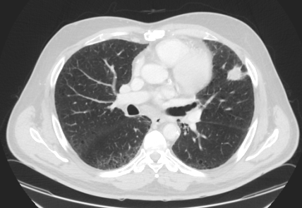
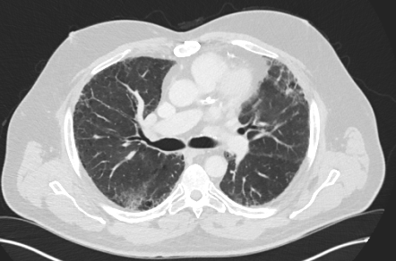
Case 1: Pt With Newly Diagnosed Stage IV Squamous NSCLC
A 61-yr-old man was recently diagnosed with stage IV squamous NSCLC
  He has bone metastasis and an ECOG PS of 1
  On biopsy, his tumor has high PD-L1 expression (TPS of 60%)
Pt is treated with palliative RT to rib lesion for pain control and started on pembrolizumab
Baseline
6.5 mos
later
Slide credit: clinicaloptions.com
Notes:
ECOG, Eastern Cooperative Oncology Group; NSCLC, non-small-cell lung cancer; PS, performance status; RT, radiation; TPS, tumor proportion score.

Slide 5
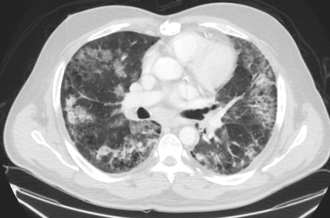
Case 1: Complications on Anti–PD-1 Therapy
Pt presents with dyspnea, a nonproductive cough, and a fever that he has had for the past 2 wks
8 mos after
starting therapy
Slide credit: clinicaloptions.com

Slide 6
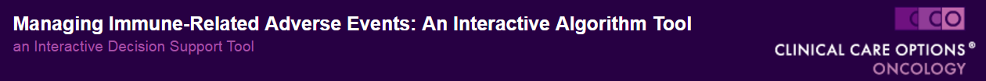
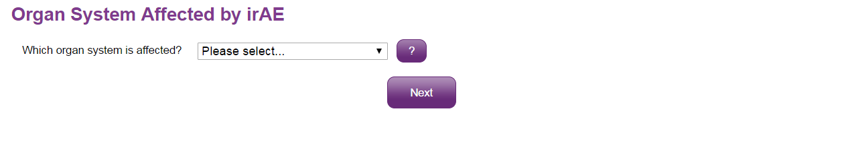
A Clinician’s Guide to Managing Immune-Related AEs: An Interactive Algorithm Tool
Please select…
Gastrointestinal (colitis, diarrhea)
Hepatic
Pulmonary (pneumonitis)
Neurologic
Dermatologic
Renal (nephritis)
Endocrine
Rheumatologic (arthritis)
Other
www.clinicaloptions.com/immuneAEtool
Notes:
AE, adverse event.

Slide 7
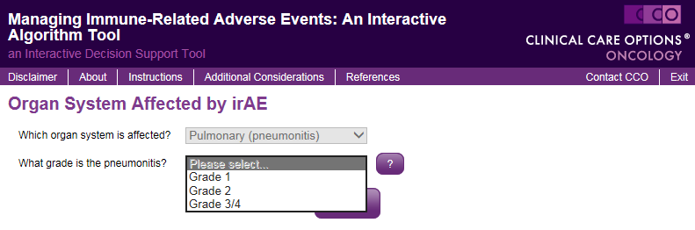
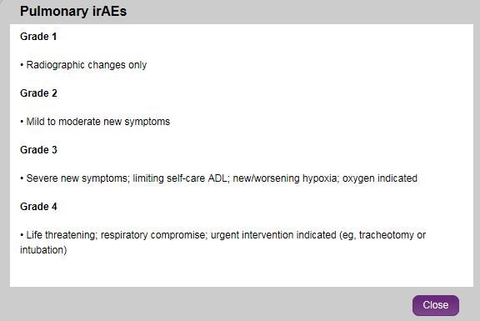
A Clinician’s Guide to Managing Immune-Related AEs: An Interactive Algorithm Tool
www.clinicaloptions.com/immuneAEtool
Notes:
AE, adverse event.

Slide 8
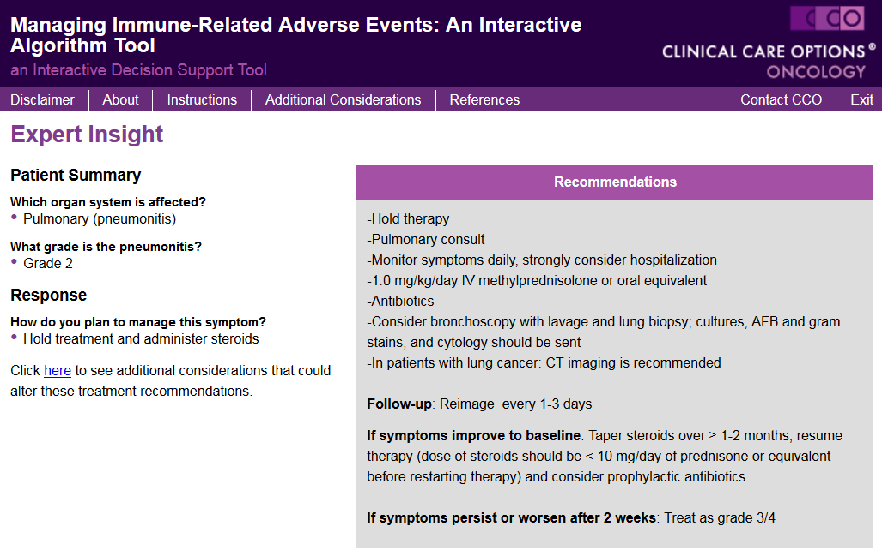
A Clinician’s Guide to Managing Immune-Related AEs: An Interactive Algorithm Tool
Available at: www.clinicaloptions.com/immuneAEtool
Slide credit: clinicaloptions.com

Slide 9
Algorithm for Managing Immune-Related Pneumonitis on PD-1/PD-L1 Inhibitor Therapy
Grade 1
Radiographic changes only
Consider delay of I-O therapy
Monitor symptoms every 2-3 days
Consider pulmonary and infectious disease consults
Reimage at least every 3 wks
If worsens: treat as grade 2-4
Grade 2
Mild to moderate new symptoms
Delay I-O therapy per protocol
Pulmonary and ID consults
Monitor symptoms and consider hospitalization
1-2 mg/kg/day prednisone equivalents
Bronchoscopy? Biopsy?
Reimage every 1-3 days
If improves: when symptoms near baseline, taper steroids over ≥ 1 mo and resume I-O therapy
Antibiotics?
If worsens: treat as grade 3/4
Grade 3-4
Severe new symptoms: new/worsening hypoxia, life threatening
Discontinue I-O therapy
Hospitalize
Pulmonary and ID consults
1-2 mg/kg/day prednisone equivalents
Antibiotics?
Bronchoscopy? Biopsy?
If improves to baseline, taper steroids over > 6 wks
If no improvement after 48 hrs or worsens: add additional immunosuppression
References in slidenotes.
Slide credit: clinicaloptions.com
Notes:
ID, infectious disease; I-O, immuno-oncology
References:
Linardou H, et al. Ann Transl Med. 2016;4:272.
Michot JM, et al. Eur J Cancer. 2016;54:139-148.
Atezolizumab [package insert]. South San Francisco, CA: Genentech, Inc.; 2016.
Pembrolizumab [package insert]. Rahway, NJ: Merck Sharp & Dohme Corp.; 2017.
Nivolumab [package insert]. Princeton, NJ: Bristol-Myers Squibb Company; 2017.
Clinical Care Options. Immune Adverse Event Management tool. Available at: www.clinicaloptions.com/ImmuneAETool

Slide 10
Case 2: Pt With Stage IV Adenocarcinoma on Investigational Combination Therapy
A 68-yr-old man diagnosed with stage IV lung adenocarcinoma
Pathology testing was negative for EGFR mutations, ALK and ROS1 translocations; 10% PD-L1 expression by IHC (22C3)
ECOG PS of 1
Elected to begin treatment with first-line ipilimumab in combination with nivolumab on a clinical trial
He achieved a PR after 4 cycles
5 mos into therapy, pt presents with 1-wk history of abdominal cramping, intermittent diarrhea, and hematochezia (grade 2)
Slide credit: clinicaloptions.com
Notes:
ECOG, Eastern Cooperative Oncology Group; PS, performance status

Slide 11
Ipilimumab: Immune-Related AEs
Mechanism-based AEs (grade ≥ 3)
  Colitis (7% to 16%)
  Hypophysitis (1.8% to 8.0%)
  Hepatitis (2% to 11%)
  Skin eruptions (2.5% to 4.0%)
  Pneumonitis
Ipilimumab [package insert]. Princeton, NJ: Bristol-Myers Squibb Company; 2015.
Michot JM, et al. Eur J Cancer. 2016;54:139-148.
Slide credit: clinicaloptions.com
Notes:
AE, adverse event.

Slide 12
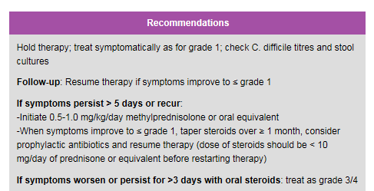
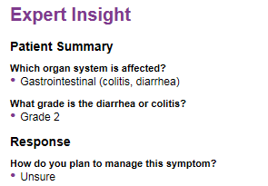
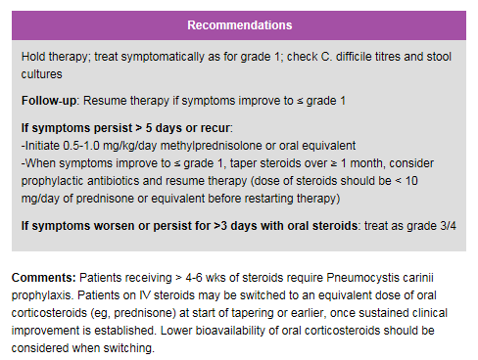
A Clinician’s Guide to Managing Immune-Related AEs: An Interactive Algorithm Tool
Available at: www.clinicaloptions.com/immuneAEtool
Slide credit: clinicaloptions.com
Notes:
AE, adverse event.

Slide 13
Gastrointestinal Immune-Related AE Management Algorithm
Grade of Diarrhea/Colitis
(NCI CTCAE v4)
Management
Follow-up
Rule out noninflammatory cause
  If noninflammatory cause, treat appropriately and continue immunotherapy
Risk of bowel perforations
  Opiates/narcotics may mask
  Avoid infliximab
May switch from IV to PO steroids taking into account lower bioavailability
Grade 1
Diarrhea: < 4 stools/day over baseline Colitis: asymptomatic
Continue I-O therapy per protocol
Symptomatic treatment
Close monitoring for worsening symptoms.
Educate pt to report worsening immediately
If worsens: treat as grade 2 or 3/4
Grade 2
Diarrhea: 4-6 stools/day over baseline; IV fluids indicated < 24 hrs;
not interfering with ADL
Colitis: abdominal pain, blood in stool
Delay I-O therapy per protocol
Symptomatic treatment
If improves to grade 1: resume I-O therapy per protocol
If persists > 5-7 days or recurs:
0.5-1.0 mg/kg/day methylprednisolone or PO equivalent
When symptoms improve to grade 1, taper steroids over at least 1 mo, consider prophylactic antibiotics for opportunistic infections, and resume I-O therapy per protocol.
If worsens or persists > 3-5 days with oral steroids: Treat as grade 3/4
Grade 3/4
Diarrhea (G3): ≥ 7 stools/day over baseline, incontinence; IV fluids ≥ 24 hrs; interfering with ADL
Colitis (G3): severe abdominal pain; medical intervention indicated,
peritoneal signs
G4: life threatening, perforation
Discontinue I-O therapy per protocol
1.0-2.0 mg/kg/day methylprednisolone IV or IV equivalent
Add prophylactic antibiotics for opportunistic infections
Consider lower endoscopy
If improves:
Continue steroids until grade 1, then taper over at least 1 mo
If persists > 3-5 days or recurs after improvement;
Add infliximab 5 mg/kg (if no contradiction).
Note: Infliximib should not be used in cases of perforation or sepsis
Villadolid J, et al. Transl Lung Cancer Res. 2015;4:560-575. Michot JM, et al. Eur J Cancer. 2016;54:139-148. Linardou H, et al. Ann Transl Med. 2016;4:272.
Slide credit: clinicaloptions.com
Notes:
ADL, activities of daily living; AE, adverse event; CTCAE, Common Terminology Criteria for Adverse Events; I-O, immuno-oncology; NCI, National Cancer Institute.

Slide 14
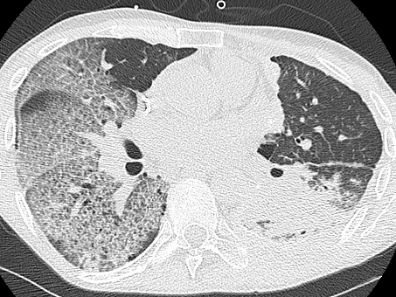
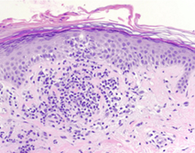
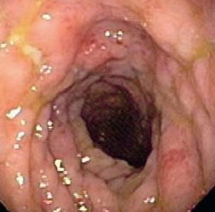
Common Immune-Related AEs Associated With Checkpoint Inhibitors
Pneumonitis (anti–PD-1)
Rash (anti–CTLA-4)^{[1]}
Reticular erythematous rash
Perivascular lymphocyte infiltrate extending into epidermis
Gastrointestinal AEs (anti–CTLA-4)^{[2]}
Colonoscopy
Histopathology
Bowel edema and ulceration in the descending colon
Focal active colitis (left) with crypt destruction, loss of goblet cells, and neutrophilic infiltrates in the crypt epithelium (right)
1. Hodi FS, et al. Proc Natl Acad Sci U S A. 2003;100:4712-4717.
2. Maker AV, et al. Ann Surg Oncol. 2005;12:1005-1016.
Slide credit: clinicaloptions.com
Notes:
AE, adverse event.

Slide 15
Distribution of Immune-Related AEs With
CTLA-4, PD-1, and PD-L1 Inhibition
Distribution of Grade 1/2
Immune-Related AEs
Distribution of Grade 3-5
Immune-Related AEs
40
CTLA-4
PD-1
PD-L1
15
CTLA-4
PD-1
PD-L1
30
10
20
Pts (%)
Pts (%)
5
10
0
0
GI
GI
GI
GI
GI
GI
Skin
Hepatic
Skin
Hepatic
Skin
Hepatic
Skin
Hepatic
Skin
Hepatic
Skin
Hepatic
Arthralgia
Arthralgia
Arthralgia
Arthralgia
Endocrine
Arthralgia
Endocrine
Endocrine
Endocrine
Arthralgia
Endocrine
Endocrine
Pulmonary
Pulmonary
Pulmonary
Pulmonary
Pulmonary
Pulmonary
Neuro or Ocular
Neuro or Ocular
Neuro or Ocular
Neuro or Ocular
Neuro or Ocular
Neuro or Ocular
Michot JM, et al. Eur J Cancer. 2016;54:139-148.
Slide credit: clinicaloptions.com
Notes:
AE, adverse event; GI, gastrointestinal.

Slide 16
General Thoughts for Managing Immune-Related AEs Associated With Immune Checkpoint Inhibitors
Result from increased or excessive immune activity
Systemic high-dose corticosteroids may be required for severe events*
Immune-related
adverse events
Can be severe or
life threatening, may involve various organs
Early diagnosis
and appropriate management essential to minimize
life-threatening complications
Unless an alternate aetiology has been identified, consider all signs and symptoms
Pt education for early recognition
*With or without additional immunosuppressive therapy.
Villadolid J, et al. Transl Lung Cancer Res. 2015;4:560-575. Michot JM, et al. Eur J Cancer. 2016;54:139-148. Linardou H, et al. Ann Transl Med. 2016;4:272.
Slide credit: clinicaloptions.com
Notes:
AE, adverse event.

Slide 17
Early Diagnosis and Management of Immune-Related AEs Is Essential
Frequent monitoring and early recognition
Pt education and assessment for appropriate signs/symptoms
at baseline and before each dose
Most AEs grade 1/2, in rare cases serious or life threatening
Immune-related AEs are well characterized, medically manageable, and typically reversible by using established algorithms^{[12]}
  Include use of corticosteroids and dose interruption/delays
  Some cases of grade 3/4 AEs managed by immunomodulators or discontinuation
Villadolid J, et al. Transl Lung Cancer Res. 2015;4:560-575. Michot JM, et al. Eur J Cancer. 2016;54:139-148. Linardou H, et al. Ann Transl Med. 2016;4:272.
Slide credit: clinicaloptions.com
Notes:
AE, adverse event.

Slide 18
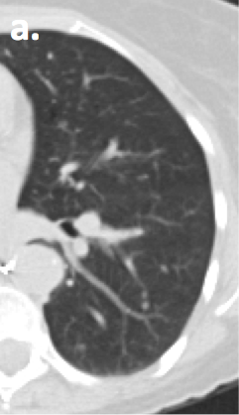
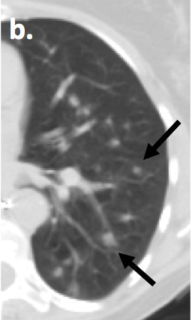
Case 3: Pt With Advanced Squamous NSCLC on Second-line Atezolizumab
A 68-yr-old woman with advanced squamous NSCLC
  Disease progression 6 mos after completing carboplatin/ gemcitabine
Elected treatment with atezolizumab as second-line therapy
CT scans performed at baseline and 2 mos later
Pt feels well overall
Baseline
2 Mos Later
Slide credit: clinicaloptions.com
Notes:
NSCLC, non-small-cell lung cancer.

Slide 19
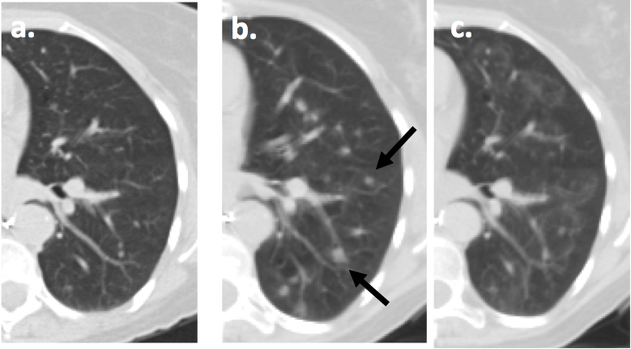
Case 3: Clinical Course
Baseline
2 Mos Later
4 Mos Later
Slide credit: clinicaloptions.com

Slide 20
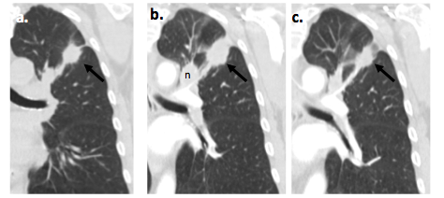
Pseudoprogression on Anti–PD-1 Therapy
Baseline
1 Mo
4 Mos
Slide credit: clinicaloptions.com

Slide 21
How Common Is Pseudoprogression in Pts With Advanced NSCLC Treated With PD-1 Inhibitors?
Nivo or Pembro
Continue Tx
Pts with advanced NSCLC
(N = 228)
Suspected pseudoprogression (n = 22)
5/15 confirmed as pseudoprogression
Clinical improvement,
enlargement of tumors
4 had increased
tumor size
1 had new lesions with decreased size
Incidence of pseudoprogression: 2.2%
Katz S, et al. J Thorac Oncol. 2017;12:S533-S544.
Slide credit: clinicaloptions.com
Notes:
Nivo, nivolumab; NSCLC, non-small-cell lung cancer; Pembro, pembrolizumab; Tx, treatment.

Slide 22
Considerations for Duration of Checkpoint Inhibitor Therapy
FDA approvals for PD-1/PD-L1 inhibitors do not specify a duration of therapy^{[1,2]}
Prolonged treatment has implications
  Cost
  Toxicity
  Pt convenience
  Unexpected findings
  Imaging and follow-up frequency
1. Atezolizumab [package insert]. 2. Pembrolizumab [package insert].
Slide credit: clinicaloptions.com

Slide 23
What Is the Optimal Duration of Immune Checkpoint Therapy?
Ipilimumab is given for up to 4 cycles in unresectable or metastatic melanoma^{[1]}
Considerations for early vs advanced-stage disease
  Ongoing trials with PD-1/PD-L1 inhibitors treat for ~ 1 yr in the adjuvant therapy setting (eg, ANVIL, PEARLS)^{[2,3]}
Continuous vs intermittent therapy?
1. Ipilimumab [package insert]. 2. ClinicalTrials.gov. NCT02595944. 3. ClinicalTrials.gov. NCT02504372.
Slide credit: clinicaloptions.com

Slide 24
Conclusions
Immune checkpoint inhibitors result in improved outcomes for several cancers including lung cancer
Early recognition of toxicity is critical to institute appropriate interventions
Pseudoprogression is a rare event in pts with advanced NSCLC who are treated with immune checkpoint inhibitors
Optimal duration of immune checkpoint therapy is yet to be defined
Slide credit: clinicaloptions.com

Slide 25
Go Online for More CCO
Coverage of Oncology!
Capsule Summaries of key ASCO 2017 abstracts on lung, skin, GI, and breast cancers
Online Interactive Decision Support Tool shows first-line and second-line treatment recommendations for advanced NSCLC from 5 experts based on key characteristics that
you enter using drop-down menus
CME/CE-certified Expert Analysis highlighting key data in lung
cancer presented at ASCO 2017
clinicaloptions.com/oncology
clinicaloptions.com/Lungtool
clinicaloptions.com/immuneAETool

